Slide 1
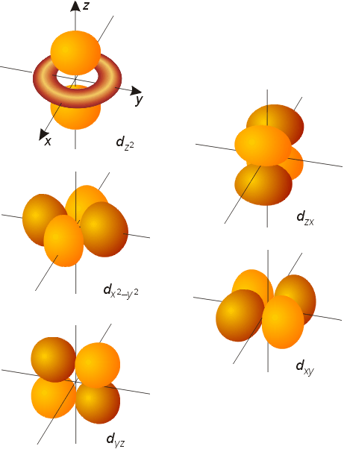
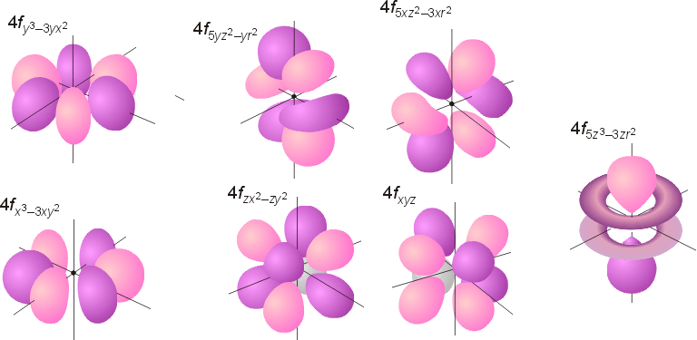
RDCH 702 Lecture 4: Orbitals and energetics
Molecular symmetry
Bonding and structure
Molecular orbital theory
Crystal field theory
Ligand field theory
Provide fundamental understanding of chemistry dictating radionuclide complexes
Structure based on bonding
Coordination important in defining structure
Structure related to spectroscopic behavior
Electron configuration important in structure
d⁸ are square planar
d⁰ and d¹⁰ tetrahedral

Slide 2
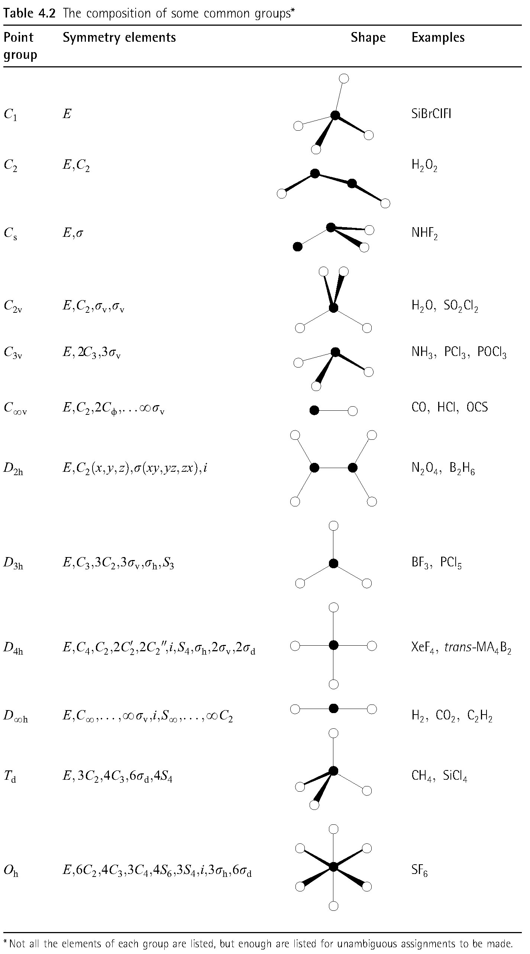
Molecular symmetry
Evaluation of point groups
Description of symmetry present in molecules
Axis
Planes
Inversion
Rotation
Use with group theory to determine spectroscopic properties

Slide 3
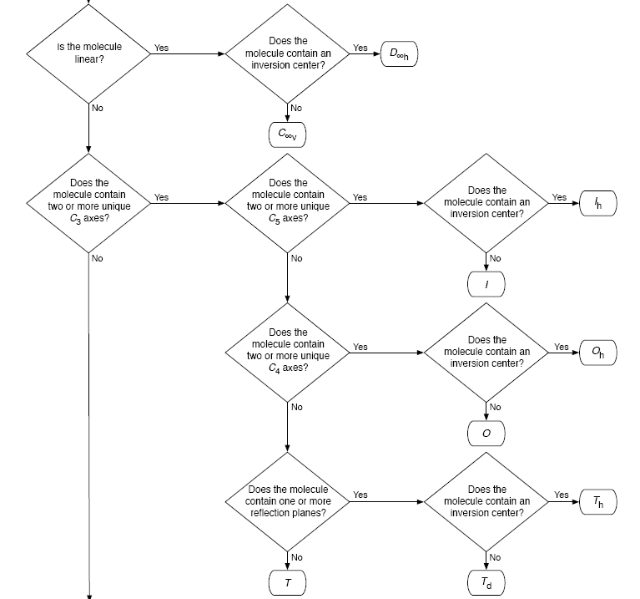
Method for determining molecular symmetry and point group
Use molecular geometry to follow chain

Slide 4
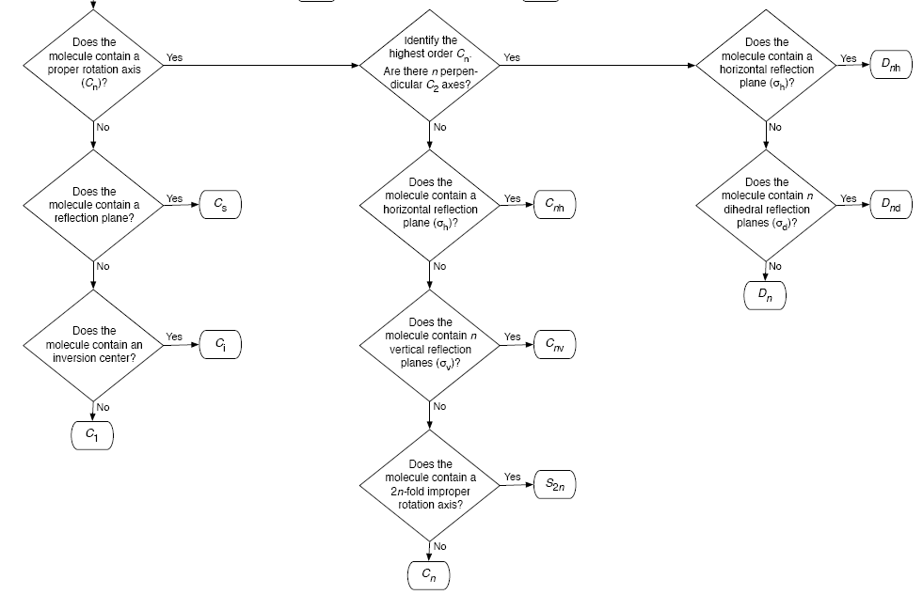
Non-linear, less than 2 unique C₃ axis

Slide 5
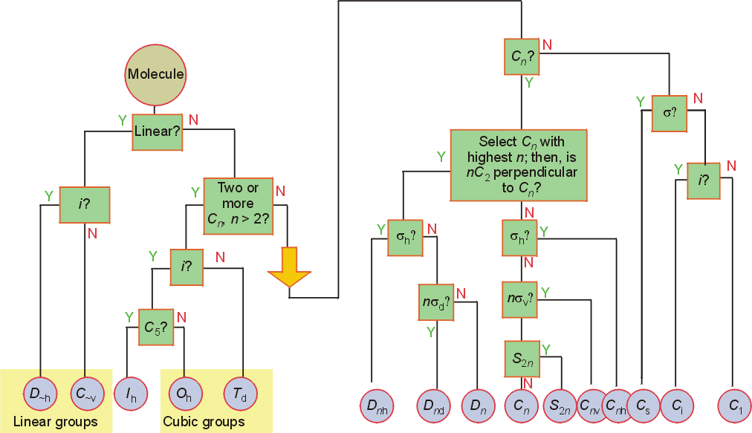
Identifying Point Group
C_{s}, C₂, C₃, D₃, C_{2v}, C_{3v}, C_{3h}
C₃
D_{3h}

Slide 6
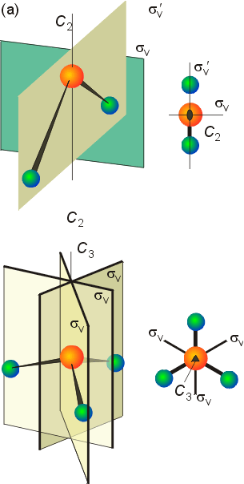
Point Groups
H₂O point group
C_{2v} symmetry
Symmetry elements
E, C₂ (180° rotation), 2 vertical mirror planes (σ_{v})
E, C₂, σ_{v}, σ_{v}’
NH₃ point group
C_{3v} point group
Elements
E, C₃ (each N-H), three vertical mirror plane through each N-H (3σ_{v})
E, C_{3,} 3σ_{v}
Apply to identification tree

Slide 7
Symmetry and spectroscopy
C_{2v} | E | C₂ | σ_{v} (xz) | σ_{v} (yz)
A₁ | 1 | 1 | 1 | 1 | z | x², y², z²
A₂ | 1 | 1 | -1 | -1 | R_{z} | xy
B₁ | 1 | -1 | 1 | -1 | x, R_{y} | xz
B₂ | 1 | -1 | -1 | 1 | y, R_{x} | yz
a₁ vibration generates a changing dipole moment in the z-direction
b₁ vibration generates a changing dipole moment in the x-direction
b₂ vibration generates a changing dipole moment in the y-direction
a₂ vibration does not generate a changing dipole moment in any direction (no ‘x’, ‘y’ or ‘z’ in the a2 row).
a₁, b₁ and b₂ vibrations provide changes dipole moments and are IR active
a₂ vibrations have no dipole moments
IR inactive
.

Slide 8
Coordination number
Geometry strongly influence by coordination number
Can assess information on potential structure and geometry from coordination number (CN)
CN=5
Interconvertibility between geometries
Compounds can vary between shapes
Trigonal bipyramid seems to be more common
Common with metal pentachloride species
N
H
H
H
B
H
H
H
CN | Geometries
2 | Linear (D_{∞h}) Bent (C_{2v})
3 | Planar (D_{3h}) Pyramidal (C_{3v}) Some T-shaped forms (C_{2v})
4 | Tetrahedral (T_{d}) Square geometry (C_{4h}) One lone pair (C_{2v})
5 | Trigonal bipyramid (D_{3h}) Square pyramid (C_{4v})
O
H
H
F
F
Pu
C
Xe
H
H
O
F
F
Cl
Cl
Cl
Cl
Cl
Cl
Cu
In
Cl
Cl
Cl
Cl

Slide 9
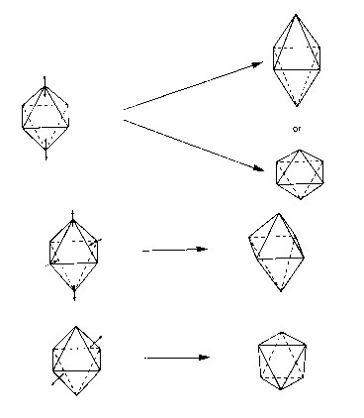
Coordination Number
Coordination number 6
Very common coordination number
Ligands at vertices of octahedron or distorted octahedron
Octahedron (O_{h})
Tetragonal octahedron (D_{4h})
Elongated or contracted long z axis
Rhombic (D_{2h})
Changes along 2 axis
Trigonal distortion (D_{3d})
O_{h} ->D_{4h}
or
O_{h} ->D_{2h}
O_{h} ->D_{3d}

Slide 10
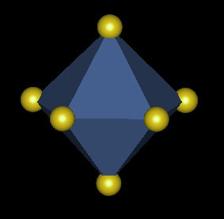
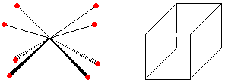
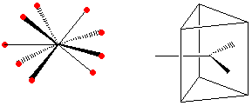
Higher coordination: Relevant for actinides
8 coordination: Cubic structure, the Square Antiprism, Dodecahedron
7 coordination
Pentagonal Bipyramidal, Capped Trigonal Prismatic and Capped Octahedral.
http://www.d.umn.edu/~pkiprof/ChemWebV2/Coordination/CN8.html
9 coordination: Tricapped trigonal prismatic

Slide 11
Hard and soft metals and ligands
Based on Lewis acid definition
Ligand acts as base
donates electron pair to metal ion
Hard metal ion interact with hard bases
Hard ligands N, O, F
Soft ligands P, S, Cl
Ligand hardness decreases down a group
Hard metals
High positive charges
Small radii
Closed shells or half filled configurations
Soft metals
Low positive charges
Large ionic radius
Non-closed shell configurations
Tend to be on right side of transition series
Lanthanides and actinides are hard
Actinides are softer than lanthanides
Ligands with soft groups can be used for actinide/lanthanide separations

Slide 12
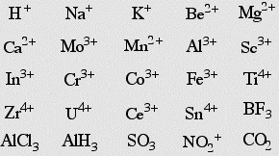
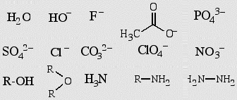
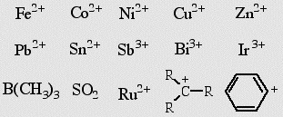
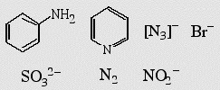
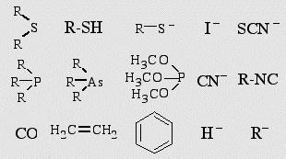
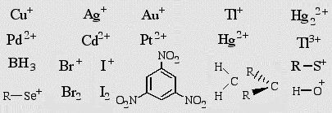
Hard
Intermediate
Soft

Slide 13
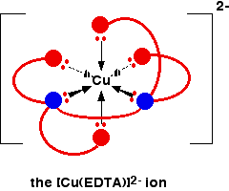
Chelation and stability
Ligands with more than 1 complexing functional group
Carbonate, ethylenediamine
Enhanced stability through chelation effect
ethylenediamine binding stronger than 2 ammonia groups
Bidentate
Tridentate
Ligands can wrap around metal ion forming stronger complex

Slide 14
Effective atomic number
Metal bonding can be described with effective atomic number
Number of electrons surrounding metal is effective atomic number
Transitions metal have 9 possible bonds
5 d, 3p, 1 s
18 electrons
Possible to have effective atomic number different than 18
Few d electrons
Electronegative ligands

Slide 15
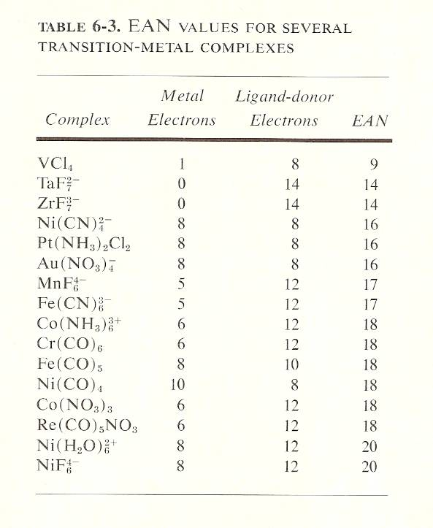
Effective atomic number
16 electron
Square planar
d⁸ configuration (Au, Pt)
Greater than 18 electron
8-10 d electrons
Expand metal-ligand interactions to exploit bonding and geometry
Molecular orbital theory
Crystal field theory
Ligand field theory

Slide 16
Molecular orbital theory
Molecular orbitals are comprised from the overlap of atomic orbitals
Number of molecular orbitals equals the number of combined atomic orbitals
Different type of molecular orbitals
bonding orbital (lower energy)
Non-bonding (same energy as atomic orbitals)
Anti-bonding orbital (higher energy)
Electrons enter the lowest orbital available
maximum number of electrons in an orbital is 2 (Pauli Exclusion Principle)
Electrons spread out before pairing up (Hund's Rule)

Slide 17
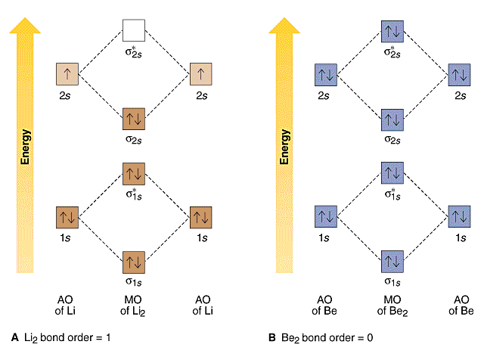
Molecular orbital

Slide 18
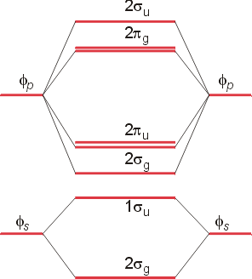
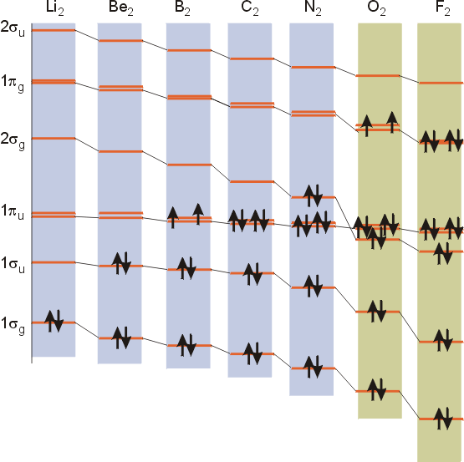
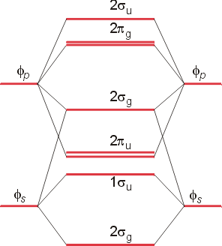
Molecular orbitals
Sigma, Pi, delta
Gerade and ungerade
N molecular orbitals from N atomic orbitals
N=8 in period 2
4 sigma, 4 Pi
Pi degenerate bonding and antibonding
O and F
Li to N

Slide 19
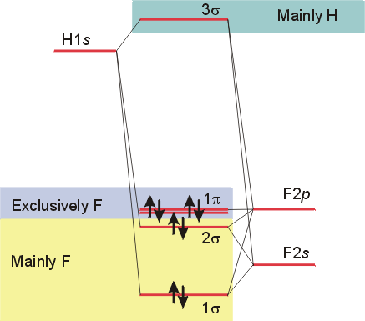
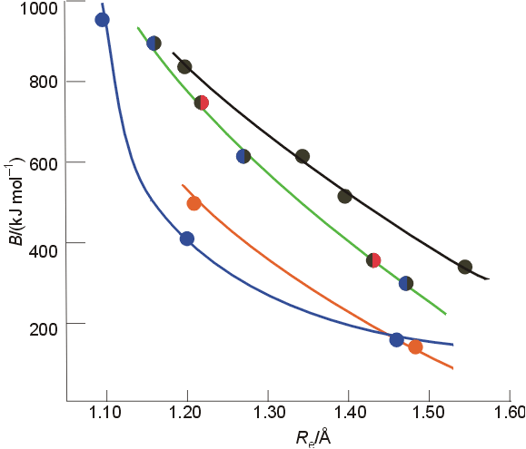
Molecular orbitals
Mixture of different atoms
Some bonding characteristics dominate
Nonbonding orbitals
No Pi from H
High occupied electron orbital
Lowest unoccupied electron orbital
Bond order
Overall shared electron
B=0.5(n-n*)

Slide 20
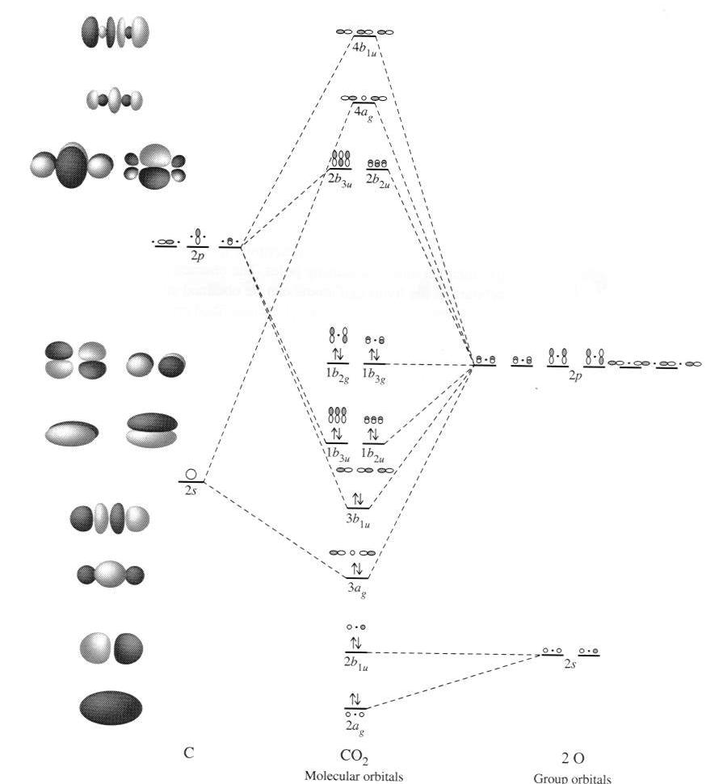
Symmetry adapted orbitals
Combination of orbitals with symmetry considerations
If molecule has symmetry degenerate atomic orbitals with similar atomic energy can be grouped in linear combinations
groups are known as symmetry-adapted linear combinations

Slide 21
Crystal Field Theory
Behavior of electrons with ligands
changes degenerate states
d and f electrons
Lone pair modeled as point
Repels electrons in d or f orbital
d orbitals have energy differences due to point
Results in ligand field splitting
About 10 % of metal-ligand interaction
e and t orbitals
Ignores covalent contribution
Energy difference is ligand field splitting parameter (Δ_{o})
Can be determined from absorption spectrum
e_{g} ←t_{2g} transition

Slide 22
Crystal Field Theory
Ti(OH₂)₆³⁺
Absorbance at 500 nm, 20000 cm⁻¹
1000 cm⁻¹ = 11.96 kJ/mol
Δ₀=239.2 kJ/mol
Δ₀ found to vary with ligand
For metal ion increases with oxidation state and increases down a group
I⁻ < Br⁻ < SCN⁻ ~C^{l-} < F⁻ < OH- ~ ONO-<C₂O₄²- < H₂O < NCS⁻ < EDTA⁴⁻ < NH₃ ~ pyr ~ en < bipy < phen < CN⁻ ~CO

Slide 23
Crystal field theory
Ligand field stabilization energies
t_{2g} stabilized (40 % of Δ_{o})
e_{g} increase energy (60 % of Δ_{o})
LFSE=(-0.4 t_{2g} + 0.6 e_{g})Δ_{o}
LFSE few % of energy

Slide 24
Crystal Field Theory
Weak and strong field limits
Related to location of 4th d⁴ electron
t_{2g}⁴ or t_{2g}³e_{g}¹
All in t_{2g} has coulombic repulsion (P) but promotion to e_{g} need Δ_{o} energy
Δ_{o}<P
Lower energy if e_{g} is occupied
Weak field
High spin
Low spin for ligands high in series with strong field
Δ_{o} and P related to metal and ligand
4d and 5d generally have Δ_{o} greater than 3d
typically low spin

Slide 25
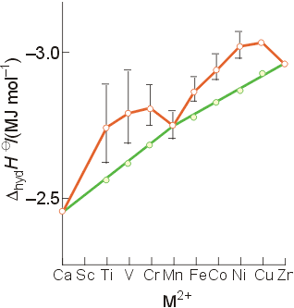
Crystal Field Theory
Magnetic properties
Determination of spin state
Diamagnetic
Move out of a magnetic field
Paramagnetic
Move into a magnetic field
Dipole moment
Spin only paramagnetism due to quenching of orbital angular momentum with ligand
μ=[N(N+2)]^{1/2} μ_{B}; with μ_{B}= 9.274E-24 JT⁻¹ and N number of unpaired electrons
For d⁶ N= 4 or 0, depending on spin
Accounts for observations on trends
Ionic radius

Slide 26
Crystal Field Theory
T_{d}
Weak field splitting
e lower energy than t
Based on orbital spatial distributions
Tetragonal complex
Splitting into 4 levels
Can distort into square planar
4d⁸ and 5d⁸
Jahn-Teller effect
Distortion of geometry to achieve energy stabilization (see previous)
Energy of distorted complex lower

Slide 27
Ligand Field Theory
Describes bonding and geometry of coordination complexes
Use of molecular orbital theory for transition metals
Correlated with geometry to identify similar bonds
Includes covalent metal-ligand interactions
Overlap of ligand and metal orbitals
Enhanced understanding of origin of energy separation

Slide 28
Ligand Field Theory d orbital hybrid
O_{h} complexes
Six similar bonds, nine valence orbitals
To make six similar bonds, mixing must occur
Hybridization of s, p, and 2 d orbitals
d_{x2-y2}, d_{z2}
d²sp³ hybrid
Interaction of d orbitals with bonding ligand results in observed properties (magnetic, color)

Slide 29
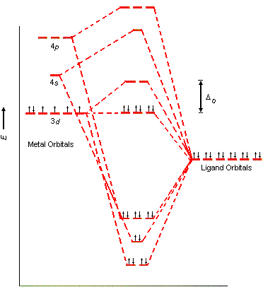
Ligand Field Theory
nd, n+1s, and n+1p orbitals on the metal overlap with one orbital on each of the six ligands
forms 15 molecular orbitals
Six are bonding
energies are lower than original atomic orbitals
Six are antibonding with higher energy
Three are nonbonding
Ligand-field theory describes how s,p, and d orbitals on the metal to overlap with orbitals on the ligand

Slide 30
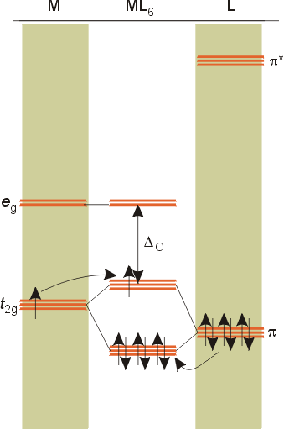
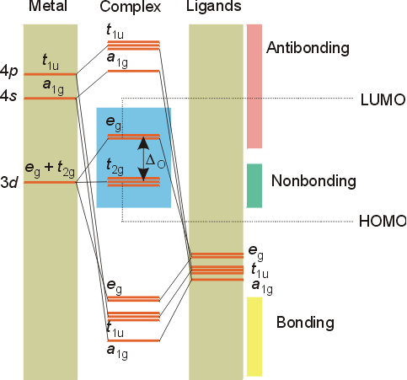
Ligand Field Theory
Treats overlaps of ligand and metal orbitals
Stems for SALC
Sigma
Combine sigma orbitals for each set
t_{2g} has no sigma
For molecular orbital combine
C_{M}ψ_{Μ}+ C_{L}ψ_{La1g}
Pi bonding
Donor decrease Δ_{ο}
Acceptor increases
Related to electrochemical series

Slide 31
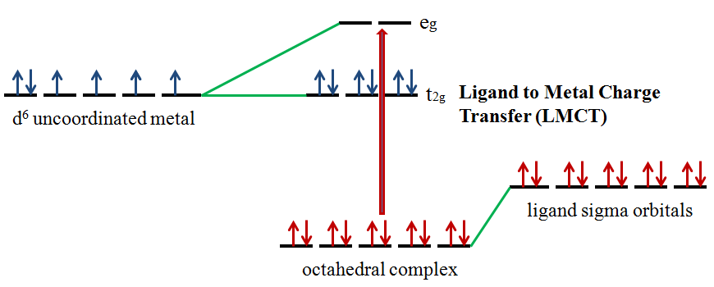
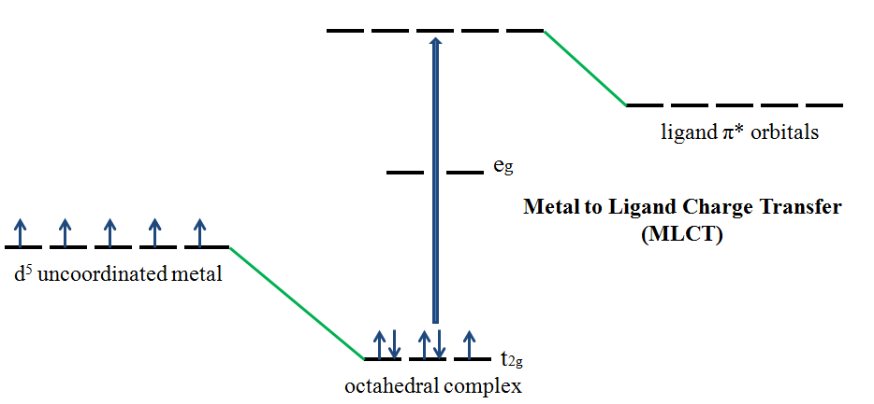
Charge transfer
Allowed transitions in UV-Visible
Ligand to metal
Metal to ligand
Related to redox of metals and ligands
MnO₄⁻
O ligands to Mn metal
Absorption of radiation involves the transfer of an electron from the donor to an orbital associated with the acceptor.
Molar absorptivities from charge-transfer absorption are large (greater that 10,000 L mol⁻¹ cm⁻¹).

Slide 32
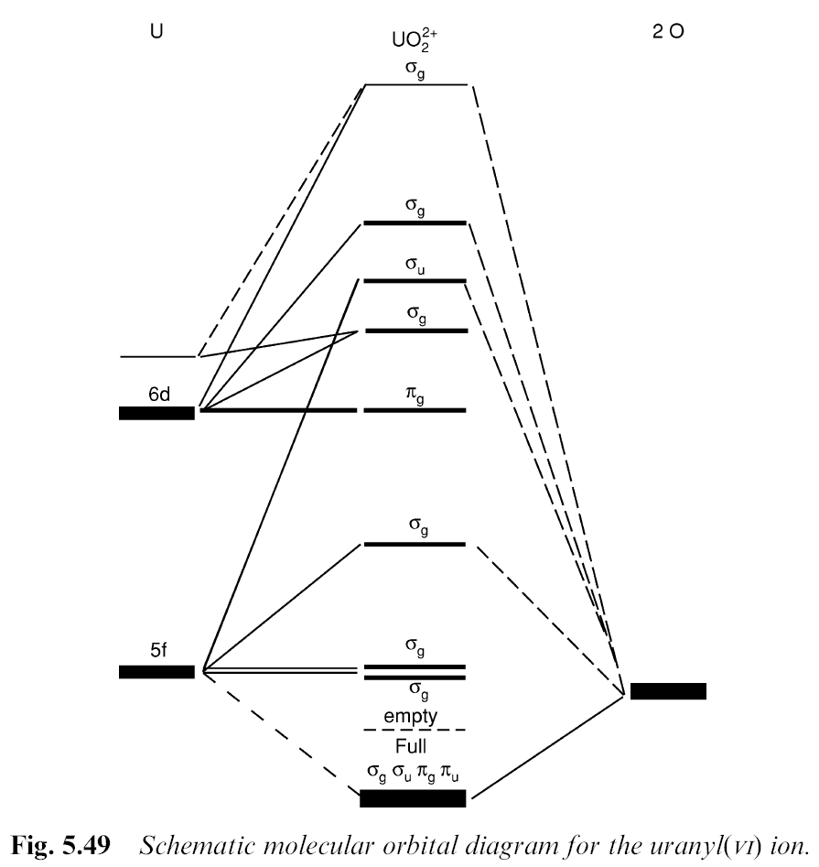
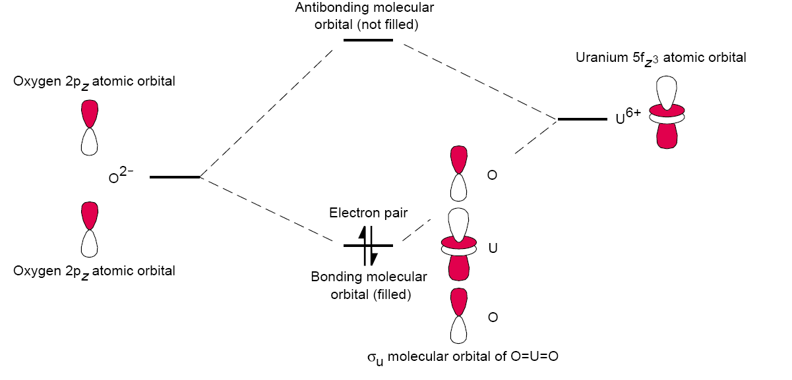
Example with UO₂²⁺
Bonding molecular orbitals
σ_{g}² σ_{u}² π_{g}⁴ π_{u}⁴
Order of HOMO is unclear
π_{g}< π_{u}< σ_{g}<< σ_{u} proposed
Gap for σ based on 6p orbitals interactions
5fδ and 5fφ LUMO
Bonding orbitals O 2p characteristics
Non bonding, antibonding 5f and 6d

Slide 33
Overview
Bonding and structure relationships
Understand how coordination number is related to geometry
Hard and soft metal interactions
First order estimation of interactions
Modeling of orbitals
Molecular orbital theory
Charge Transfer
Ligand field theory
Utility of each concept
Exploration of energy difference

Slide 34
Questions
What are the possible geometry for a 5 coordinate compound?
Which ligands would be expected to bind strongly with Fe? With Hg?
What is the chelate effect?
What is the relationship between molecular orbital theory, crystal field theory, and ligand field theory?
What does IR and UV-Visible spectroscopy inform about a chemical species?
What accounts for color changes in metal-ligand complexes?

Slide 35
Questions
Comment on blog
Respond to PDF Quiz 4

